Slide 1
Chapter 9: Fundamental Security
IT Essentials: PC Hardware and Software v4.1
Notes:
Cisco Networking Academy program
IT Essentials: PC Hardware and Software v4.1
Chapter 9: Fundamental Security

Slide 2
Chapter 9 Objectives
9.1 Explain why security is important
9.2 Describe security threats
9.3 Identify security procedures
9.4 Identify common preventive maintenance techniques for security
9.5 Troubleshoot security
Notes:
Chapter 9 Objectives

Slide 3
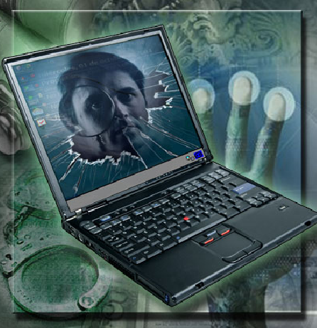
The Importance of Security
Private information, company secrets, financial data, computer equipment, and items of national security are placed at risk if proper security procedures are not followed.
A technician’s primary responsibilities include data and network security.
Notes:
9.1 Explain why security is important
Technicians need to understand computer and network security. Private information, company secrets, financial data, computer equipment, and items of national security are placed at risk if proper security procedures are not followed.
Student Activity: The student course content includes the worksheet, 9.1 Worksheet: Security Attacks. To complete this worksheet, students will conduct research on computer crime and security attacks. Describe the incident in writing. Explain if the incident could have been prevented and if so, list the precautions that might have been used.

Slide 4
Security Threats
Types of attacks to computer security:
Physical
  Theft, damage, or destruction to computer equipment.
Data
  Removal, corruption, denial of access, unauthorized access, or theft of information.
Potential threats to computer security:
Internal threats
  Employees can cause a malicious threat or an accidental threat.
External threats
  Outside users can attack in an unstructured or structured way.
Notes:
9.2 Describe security threats
External threats from those outside of an organization that do not have authorized access. Outside users may attempt an unstructured attack by using available resources (passwords or scripts) to gain access. They may also attempt a structured attack by using code to access to computer network or resources.

Slide 5
Viruses, Worms, and Trojan Horses
Malicious software (malware) is any software designed to damage or to disrupt a system:
  Virus is a software code that is deliberately created by an attacker. Viruses may collect sensitive information or may alter or destroy information.
  A worm is a self-replicating program that uses the network to duplicate its code to the hosts on the network. At a minimum, worms consume bandwidth in a network.
  A Trojan horse is technically a worm and is named for its method of getting past computer defenses by pretending to be something useful.
Anti-virus software is designed to detect, disable, and remove viruses, worms, and Trojan horses before they infect a computer.
Notes:
9.2.1 Define viruses, worms, and Trojan horses
Types of malware are; viruses, worms, Trojan Horses, adware, spyware, grayware, and other unwanted software.
Student Activity: The student course content includes the worksheet, 9.2.1 Worksheet: Third-Party Anti-Virus Software. To complete this worksheet, students will conduct research on four different third-party anti-virus software programs. Record details of each. Recommend one for purchase.

Slide 6
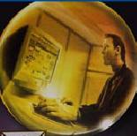
Web Security
Attackers may use any of these tools to install a program on a computer.
ActiveX
  Controls interactivity on web pages
Java
  Allows applets to run within a browser
  Example: a calculator or a counter
JavaScript
  Interacts with HTML source code to allow interactive web sites
  Example: a rotating banner or a popup window
Notes:
9.2.2 Explain web security
Tools that are used to make web pages more powerful and versatile can also make computers more vulnerable to attacks.
ActiveX was created by Microsoft to control interactivity on web pages. If ActiveX is on a page, an applet or small program has to be downloaded to gain access to the full functionality.
Java is a programming language that allows applets to run within a web browser. Examples of applets include a calculator or a counter.
JavaScript is a programming language developed to interact with HTML source code to allow interactive web sites. Examples include a rotating banner or a popup window.
To prevent against these attacks, most browsers have settings that force the computer user to authorize the downloading or use of ActiveX, Java, or JavaScript

Slide 7
Adware, Spyware, and Grayware
Typically installed without the user’s knowledge, these programs collect information stored on the computer, change the computer configuration, or open extra windows on the computer and all without the user’s consent.
  Adware displays advertising, usually in a popup window.
  Grayware or malware is a file or program other than a virus that is potentially harmful.
  Spyware, a type of grayware, is distributed without any user intervention of knowledge.
  Phishing is a form of social engineering where the attacker pretends to represent a legitimate outside organization.
Notes:
9.2.3 Define adware, spyware, and grayware
Adware displays advertising, usually in a popup window.
Grayware or malware is a file or program other than a virus that is potentially harmful. Many grayware attacks are phishing attacks that try to persuade the reader to unknowingly provide attackers with access to personal information.
Spyware, a type of grayware, is distributed without any user intervention of knowledge. Spyware monitors computer activity then sends the information back to the organization responsible for launching the spyware.
Phishing is a form of social engineering where the attacker pretends to represent a legitimate outside organization. The attacker might ask for verification of information, such as a password or username, to supposedly prevent some terrible consequence from occurring.
NOTE: There is rarely a need to give out sensitive personal or financial information online. Be suspicious. Use the postal service to share sensitive information.
Spyware and adware removal tools are available to remove adware, spyware, and grayware from a computer.
Student Activity: The student course content includes a matching activity. To complete this activity, students will match each of the words (adware, spyware, and phishing) to the appropriate definition.

Slide 8
Denial of Service (DoS)
Prevents users from accessing normal services
Sends enough requests to overload a resource or even stopping its operation
  Ping of Death is a series of repeated, larger than normal pings intended to crash the receiving computer
  E-mail Bomb is a large quantity of bulk e-mail
  that overwhelms the e-mail server preventing users from accessing e-mail
  Distributed DoS is an attack launched from many computers, called zombies
Notes:
9.2.4 Explain Denial of Service
Denial of Service (DoS) is a form of attack that prevents users from accessing normal services, such as e-mail or a web server, because the system is busy responding to abnormally large amounts of requests. DoS works by sending enough requests for a system resource that the requested service is overloaded and ceases to operate.
Ping of Death – A series of repeated, larger than normal pings that are intended to crash the receiving computer
E-mail Bomb - A large quantity of bulk e-mail that overwhelms the e-mail server preventing users from accessing e-mail
Distributed DoS (DDoS) uses many infected computers, called zombies, to launch an attack. With DDoS, the intent is to obstruct or overwhelm access to the targeted server. Zombie computers located at different geographical locations make it difficult to trace the origin of the attack.

Slide 9
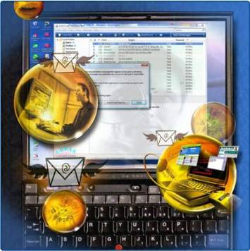
Spam and Popup Windows
Spam is unsolicited email that can be used to send harmful links or deceptive content.
Popups are windows that automatically open and are designed to capture your attention and lead you to advertising sites.
Use anti-virus software, options in e-mail software, popup blockers, and common indications of spam to combat these.
Notes:
9.2.5 Describe spam and popup windows
Spam, also known as junk mail, is unsolicited e-mail. In most cases, spam is used as a method of advertising. However, spam can be used to send harmful links or deceptive content.
When used as an attack method, spam may include links to an infected website or an attachment that could infect a computer. These links or attachments may result in lots of windows designed to capture your attention and lead you to advertising sites. These windows are called popups. Uncontrolled popup windows can quickly cover the user's screen and prevent any work from getting done.
To combat spam and phishing, use anti-virus software and setting options in e-mail. Some spam still may get through, so look for these common indications of spam; no subject line, incomplete return address, computer generated e-mails, and return e-mails not sent by the user.

Slide 10

Social Engineering
A social engineer is a person who is able to gain access to equipment or a network by tricking people into providing the necessary access information.
  Never give out a password
  Always ask for the ID of the unknown person
  Restrict access of unexpected visitors
  Escort all visitors through the facility
Notes:
9.2.6 Explain social engineering
A social engineer may gain the confidence of an employee to convince them to divulge username and password information or may pose as a technician to attempt to gain entry into a facility. A social engineer would be likely to speak using computer terminology and/or to dress similar to the type of worker they are pretending to be, including carrying equipment.
To protect against social engineering:
Never give out a password
Always ask for the ID of the unknown person
Restrict access of unexpected visitors
Escort all visitors through the facility
How many people know someone who writes a password on a note and sticks it to the monitor or under the keyboard?

Slide 11
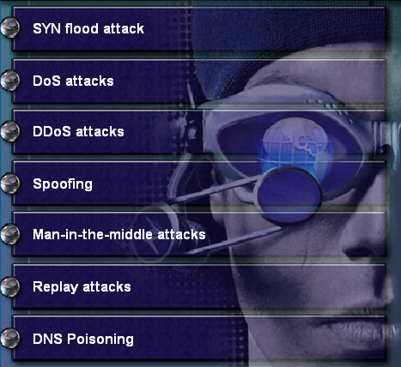







TCP/IP Attacks
TCP/IP is used to control all Internet communications.
Notes:
9.2.7 Explain TCP/IP attacks
TCP/IP is the protocol suite used to control all communications on the Internet. The most common TCP/IP attacks are:
SYN Flood randomly opens TCP ports, tying up the network equipment or computer with a large amount of false requests, causing sessions to be denied to others
DoS sends abnormally large amounts of requests to a system, preventing access to the services
DDoS DoS attack using “zombies” to make tracing the origin of the attack difficult to locate
Spoofing gains access to resources on devices by pretending to be a trusted computer
Man-in-the-Middle intercepts or inserts false information in traffic between two hosts
Replay uses network sniffers to extract usernames and passwords to be used at a later date to gain access
DNS Poisoning changes the DNS records on a system to point to false servers where the data is recorded

Slide 12
Computer Disposal and Recycling
Erase all hard drives, then use a third-party tool to fully erase all data.
The only way to fully ensure that data cannot be recovered from a hard drive is to carefully shatter the platters with a hammer and safely dispose of the pieces.
To destroy software media (floppy disks and CDs), use
a shredding machine designed for shredding these materials.
Three methods are commonly used to either destroy or recycle data and hard drives:
  Data wiping
  Hard drive destruction
  Hard drive recycling
Notes:
9.2.8 Explain data wiping, hard drive destruction and recycling
Three methods are commonly used to either destroy or recycle data and hard drives:
Data wiping
Hard drive destruction
Hard drive recycling

Slide 13
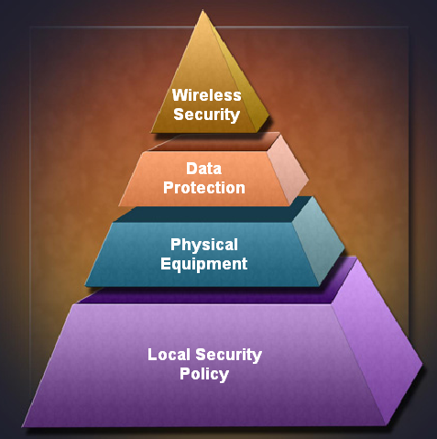
Security is Strengthened in Layers
Notes:
9.3 Identify security procedures
Security is Strengthened in Layers
Technicians should use a security plan with clear procedures to determine what to do in a critical situation.
Security plan policies should be updated regularly as new threats are released daily. Overall security plans should be reviewed on a yearly basis.
Conduct regular tests to determine areas where security is weak.
There are multiple layers of security in a network that are vulnerable to attack, including physical, wireless, and data layers.
Teaching Strategy: A computer technician will need to know how to implement security procedures in order to protect a computer and information from data loss, corruption, and theft (hardware or data). Security plans are maintained and updated on a regular basis. An appropriate implementation of computer security will implement several layers of security. Security is strengthened in layers.
After completing this section, students will meet these objectives:
Explain what is required in a basic local security policy
Explain the tasks required to protect physical equipment
Describe ways to protect data
Describe wireless security techniques

Slide 14
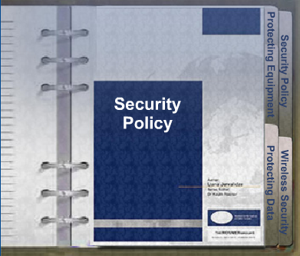
Security Policy
A security policy should describe how a company addresses security issues, as shown in Figure 1.
Questions to answer in writing a local security policy:
  What assets require protection?
  What are the possible threats?
  What should be done in the event of a security breach?
Notes:
9.3.1 Explain what is required in a basic local security policy
Elements to include in a security policy:
A process for handling network security incidents
A process for auditing existing network security
A general security framework for implementing network security
Behaviors that are allowed
Behaviors that are prohibited
What to log and how to store the logs: Event Viewer, system log files, or security log files
Network access to resources through account permissions
Authentication technologies to access data: usernames, passwords, biometrics, smart cards
Teaching Strategy: Security policies describe what to do when faced with many emergencies. It is important to develop and distribute the security policy BEFORE the emergency happens. Local security policies may vary from company to company. They may also vary depending on the device to secure.

Slide 15
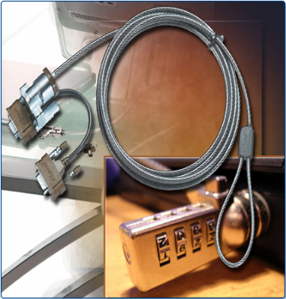
Protecting Equipment
Since stealing the whole PC is the easiest way to steal data, physical computer equipment must be secured.
Some methods of physically protecting computer equipment are:
    Control access to facilities
    Use cable locks with equipment
    Keep telecommunication rooms locked
    Fit equipment with security screws
Some means to protecting access to facilities are:
    Card keys are identity cards with a chip that stores user data, including the level of access
    Berg connectors for connecting to a floppy drive
    Biometric sensors that identify physical characteristics of the user, such as a fingerprint or retina
Notes:
9.3.2 Explain the tasks required to protect physical equipment
Protecting Equipment
When a computer is stolen, the data is also stolen. There are several methods of physically protecting computer equipment:
Use security cages around equipment
Label and install sensors, such as Radio Frequency Identification (RFID) tags, on equipment
Install physical alarms triggered by motion-detection sensors.
Use webcams with motion-detection and surveillance software.
There are several means of protecting access to facilities:
Posted security guard
Sensors, such as RFID tags, to monitor equipment
One form of hardware security is the Trusted Platform Module (TPM). The TPM is a specialized chip installed on the motherboard of a computer to be used for hardware and software authentication.
TPM stores information specific to the host system, such as:
encryption keys
digital certificates
passwords
Applications that use encryption can make use of the TPM chip to secure things like:
user authentication information
software license protection
encrypted files, folders, and disks
Teaching Strategy: Since stealing the whole PC is the easiest way to steal data; physical computer equipment must be secured.

Slide 16
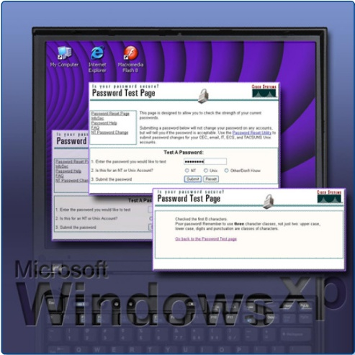
Protecting Data
The value of physical equipment is often far less than the value of the data it contains. To protect data, there are several methods of security protection that can be implemented.
  Password protection
  Data encryption
  Software Firewall
  Data backups
  Smartcard Security
  Biometric Security
  File system security
Notes:
9.3.3 Describe ways to protect data
Password protection can prevent unauthorized access to content. Password policies should include:
Expire after a set period of time
Contain a mixture of letters and numbers
Prevent users from leaving written passwords in view
Lockout rules to limit the number of unsuccessful attempts
Data encryption uses codes and ciphers. Virtual Private Network (VPN) uses encryption to protect data. A VPN connection allows a remote user to safely access resources as if their computer is physically attached to the local network.
Software Firewall Every communication using TCP/IP is associated with a port number. HTTPS, for instance, uses port 443 by default. A firewall is a way of protecting a computer from intrusion through the ports. The user can control the type of data sent to a computer by selecting which ports will be open and which will be secured.
Data backups are one of the most effective ways of protecting against data loss. Establish data backup procedures which account for frequency of backups, storage for data backups, and securing data backups using passwords.
Smart Card Security Smart cards store private information such as bank account numbers, personal identification, medical records, and digital signatures. Smart cards provide authentication and encryption to keep data safe.
Biometric Security compares physical characteristics against stored profiles to authenticate people. A profile is a data file containing known characteristics of an individual such as a fingerprint or a handprint. Common biometric devices available include fingerprint readers, handprint readers, iris scanners, and face recognition devices.
File system security All file systems keep track of resources, but only file systems with journals can log access by user, date, and time. The FAT 32 file system lacks both journaling and encryption capabilities. As a result, situations that require good security are usually deployed using a file system such as NTFS, which is part of Windows 2000 and Windows XP. If increased security is needed, it is possible to run certain utilities, such as CONVERT, to upgrade a FAT 32 file system to NTFS. The conversion process is not reversible. It is important to clearly define your goals before making the transition.
Teaching Strategy: Keeping control of data is as important as not losing it.

Slide 17
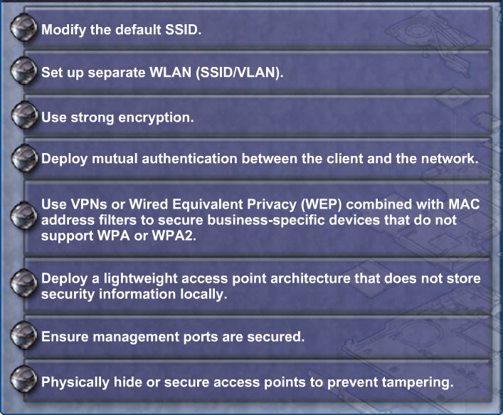
Wireless Security Techniques
Notes:
9.3.4 Describe wireless security techniques
Attackers gain access to a network by being within range of an unprotected wireless network. When installing wireless services, you should apply wireless security techniques immediately in order to prevent unwanted access to the network.
Use a wireless encryption system to encode data and thereby prevent unwanted capture and use of the data. Both ends of every link must use the same encryption standard.
The following items are basic security settings that can be configured on a wireless router or access point:
Service Set Identifier (SSID) – The name of the wireless network. A wireless router or access point broadcasts the SSID by default so that wireless devices can detect the wireless network. Manually enter the SSID on wireless devices to connect to the wireless network when the SSID broadcast has been disabled on the wireless router or access point.
MAC Address Filtering – A technique used to deploy device-level security on a wireless LAN. Because every wireless device has a unique MAC address, wireless routers and access points can prevent wireless devices from connecting to the wireless network if the devices do not have authorized MAC addresses. Enable MAC address filtering, and list each wireless device MAC address to enforce MAC address filtering.
The following items are wireless encryption and authentication technologies:
Wired Equivalent Privacy (WEP) was the first-generation security standard for wireless. Attackers quickly discovered that WEP encryption was easy to break. The encryption keys used to encode the messages could be detected by monitoring programs.
Wi-Fi Protected Access (WPA) was created as a temporary solution until the 802.11i (a security layer for wireless systems) was fully implemented. Now that 802.11i has been ratified, WPA2 has been released. It covers the entire 802.11i standard.
Lightweight Extensible Authentication Protocol (LEAP), also called EAP-Cisco, is a wireless security protocol created by Cisco to address the weaknesses in WEP and WPA. LEAP is a good choice when using Cisco equipment in conjunction with operating systems such as Windows and Linux.
Wireless Transport Layer Security (WTLS) is a security layer used in mobile devices that employ the Wireless Applications Protocol (WAP). Mobile devices do not have a great deal of spare bandwidth to devote to security protocols. WTLS was designed to provide security for WAP devices in a bandwidth-efficient manner.
Teaching Strategy: Wireless is very convenient but when you send messages over the air you make it easier for an attacker to join your network or monitor your incoming and outgoing traffic. A computer technician must know how to configure wireless NICs and access points using the appropriate level of security. The default settings on an access point are designed for fast connectivity and are not secure. Some of the changes to be made to the default settings of the access point might include; disable DHCP and use static IP addresses, change SSID from default, disable SSID broadcast, change default username and password, update firmware, and enable a firewall.
Student Activity: The student course content includes a Packet Tracer activity, 9.3.4 Packet Tracer Activity, Connecting Wireless PCs to a Linksys WRT300N. Configure basic wireless settings on a PC, configure basic security on the Linksys WRT300N then verify full connectivity.

Slide 18
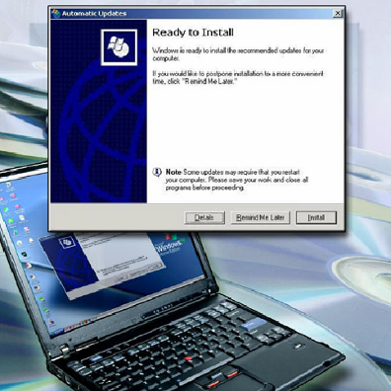
Installing Updates and Patches
Regular security updates are essential in order to meet the threat from attackers constantly searching for new ways of breaching security.
A technician should understand how to install patches and updates. They should also be able to recognize when new updates and patches are available.
Notes:
9.4 Identify common preventive maintenance techniques for security
Teaching Strategy: Attackers methods are constantly changing. As new exploits are discovered, manufacturers create patches and new procedures. The technician must be able to install these and the user should know how to recognize when updates are needed.
9.4.1 Explain how to update signature files for anti-virus and anti-spyware software
Virus, spyware, and adware detection programs look for signatures (patterns in the programming code) of the software in a computer. The publishers of protection software compile the signatures into virus definition tables. Always retrieve the signature files from the manufacturer’s website or one of their mirror sites to make sure the update is authentic and not corrupted by viruses.
CAUTION: When downloading the signature files from a mirror, ensure that the mirror site is a legitimate site. Always link to the mirror site from the manufacturer’s website.
Steps to manually update signature files for anti-virus and anti-spyware software programs
Step 1 Create a restore point in case there is a problem with the update.
Step 2 Open the anti-virus or anti-spyware program.
Step 3 Locate the update control button and select it.
Step 4 After the program is updated, use it to scan your computer.
Step 5 After the scan, check the resulting report for viruses or spyware that need to be treated or deleted manually.
Step 6 Set the protection software to update automatically and to scan on a scheduled basis.
Teaching Strategy: People who write viruses and worms constantly push the state of the art in computing. Virus checking software must be constantly upgraded to counteract these emerging, changing threats.
9.4.2 Explain how to install operating systems service packs and security patches
Because some viruses and worms can be difficult to remove from a computer, some manufacturers have designed tools specifically for the purpose. Follow these steps to update an operating system for service packs or security patches:
Create a restore point in case there is a problem with the update. A restore point should be set before running a repair application. If the repair process corrupts the operating system or application software, the technician is able to return to the restore point before the repair process began.
Check for updates to ensure that you have the latest ones available.
Download updates using Automatic Updates or from the operating system manufacturer’s website.
Install the update.
Restart the computer, if prompted.
Test all aspects to ensure that the update has not caused any issues.
Student Activity: The student course content includes the worksheet, 9.4.2 Worksheet: Operating System Updates. To complete this worksheet, students will conduct research for available updates for a particular operating system. List the configuration options for updating the OS and select one method over the rest.

Slide 19
Troubleshooting Process
Step 1 Identify the problem
Step 2 Establish a theory of probable causes
Step 3 Determine an exact cause
Step 4 Implement a solution
Step 5 Verify solution and full system functionality
Step 6 Document findings
Notes:
9.5 Troubleshooting security
Describe how to troubleshoot a laptop
Troubleshooting security is similar to troubleshooting other hardware or software problems on a computer. Promptness is vital when troubleshooting a breach in security. There is often a risk of the problem spreading to other equipment.
After completing this section, students will meet these objectives:
Review the troubleshooting process.
Identify common problems and solutions.

Slide 20
Step 1 - Identify the Problem
System Information
  Manufacturer, model, OS, network environment, connection type
Open-ended questions
  When did the problem start?
  What problems are you experiencing?
  What websites have you visited recently?
  What security software is installed in your computer?
  Who else has used your computer recently?
Closed-ended questions
  Is your security software up to date?
  Have you scanned your computer recently for viruses?
  Did you open any attachments from a suspicious e-mail?
  Have you changed your password recently?
  Have you shared your password?
Notes:
9.5.1 Review the troubleshooting process
Identify the Problem

Slide 21
Step 2 - Establish a Theory of Probable Causes
Problem may be simpler than the customer thinks.
Create a list of the most common reasons why the
error would occur.
  Virus
  Trojan Horse
  Worm
  Spyware
  Adware
  Grayware or Malware
  Phishing scheme
  Password compromised
  Unprotected equipment rooms
  Unsecured work environment
Notes:
9.5.1 Review the troubleshooting process
Establish a Theory of Probable Causes

Slide 22
Step 3 - Determine the Exact Cause
Test your theories of probable causes one at a time, starting with the quickest and easiest.
  Disconnect from the network
  Update anti-virus and spyware signatures
  Scan computer with protection software
  Check computer for the latest OS patches and updates
  Reboot the computer or network device
  Login as a different user to change your password
  Secure equipment rooms
  Secure work environment
  Enforce security policy
If the exact cause of the problem has not been determined after you have tested all your theories, establish a new theory of probable causes and test it.
Notes:
9.5.1 Review the troubleshooting process
Determine the exact cause

Slide 23
Step 4 - Implement a Solution
Sometimes quick procedures can determine the exact cause of the problem or even correct the problem.
If a quick procedure does not correct the problem, you might need to research the problem further to establish the exact cause.
Divide larger problems into smaller problems that can be analyzed and solved individually.
Notes:
9.5.1 Review the troubleshooting process
Implement a Solution
If a quick procedure does correct the problem, you can go to step 5 to verify the solution and full system functionality.
Evaluate the problem and research possible solutions. Divide larger problems into smaller problems that can be analyzed and solved individually. Prioritize solutions starting with the easiest and fastest to implement.
Check:
Helpdesk repair logs
Other techs
Manufacturer FAQs
Technical websites
News groups
Computer manuals
Device manuals
Online forums
Internet search

Slide 24
Step 5 - Verify Solution and System Functionality
Verifying full system functionality and implementing any preventive measures if needed.
  Re-scan computer to ensure no viruses remain.
  Re-scan computer to ensure no spyware remains.
  Check the security software logs to ensure no problems remain.
  Test network and Internet connectivity.
  Ensure all application are working.
  Verify access to authorized resources such as shared printer and databases..
  Make sure entries are secured.
  Ensure security policy is enforced.
Have the customer verify the solution and system functionality.
Notes:
9.5.1 Review the troubleshooting process
Verify Solution and System Functionality
NOTE: Never ask a customer to reveal a password. If you need to access a computer and the customer cannot stay nearby, have the customer create a temporary password. Advise the customer to reset the password when the repair is complete.

Slide 25
Step 6 - Document Findings
Discuss the solution with the customer
Have the customer confirm that the problem has been solved
Document the process
  Problem description
  Solution
  Components used
  Amount of time spent in solving the problem
Notes:
9.5.1 Review the troubleshooting process
Document Findings

Slide 26
Common Problems and Solutions
Laptop problems can be attributed to hardware, software, networks, or some combination of the three. You will resolve some types of laptop problems more often than others.
Notes:
9.5.2 Identify common problems and solutions
[Direct the students to the curriculum to see all the charts explaining more common problems and solutions]
Computer problems can be attributed to hardware, software, connectivity issues, or some combination of the three. You will resolve some types of computer problems more often than others. The worksheet is designed to reinforce your communication skills to verify information from the customer.
Other common printer problems and possible causes to consider:
Problem: A computer runs updates and requires rebooting at inconvenient times.
Possible solutions might be to set Windows Automatic Update to run daily at a convenient time, such as lunchtime.
Problem: A wireless network is compromised even though 64-bit WEP encryption is in use.
Possible solutions might be to upgrade to 128-bit WEP security, WAP, or EAP-Cisco security.
Problem: A stolen laptop is returned by the police. It is no longer needed by the user.
After recovering any sensitive data, destroy the hard drive and recycle the computer.
Problem: A user complains that his system is receiving hundreds or thousands of junk e-mails daily.
This may be a denial of service attack. At the e-mail server, filter out e-mail from the sender.
Problem: A printer repair person no one remembers seeing before is observed looking under keyboards and on desktops.
Contact security or police. Advise users never to hide passwords near their work area.
Student Activity: The student course content includes the worksheet, 9.5.2 Gather Information from the Customer. To complete this worksheet, students will document information gathered from the customer in a troubleshooting incident. This activity is designed to help the student understand how to condense information and document issues. The instructor can create additional scenarios to provide students more opportunities to practice this skill. (Note: This worksheet is designed as a role-playing activity. Students work in pairs. One student plays the role of the customer and uses the information on page 2, “Student Customer Sheet”, to report the problem to the other student. The other student plays the role of the level-one technician and will complete the work order, which is page 1.)

Slide 27
Chapter 9 Summary
Following proper security procedures will protect computers and network equipment, and the data they contain, from physical danger such as fire and theft, as well as from loss and damage by employees and attackers.
Security threats can come from inside or outside of an organization.
Viruses and worms are common threats that attack data.
Develop and maintain a security plan to protect both data and physical equipment from loss.
Keep operating systems and applications up to date and secure with patches and service packs.
Notes:
Chapter 9 Summary

Slide 28
